Slide 1

TOTORO Chat
Week-08

Slide 2
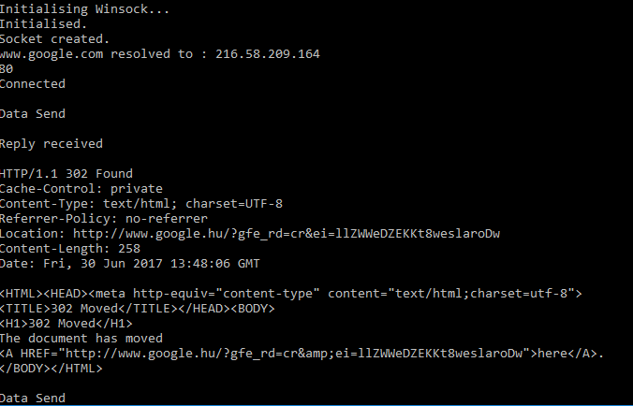
GET HOST BY NAME

Slide 3
CLIENT-SERVER COMMUNICATION
CLIENT
WSAStartup(…);
socket(…);
connect(…);
while (1){
send(…);
recv(…);
}
closesocket(…);
WSACleanup();
SERVER
WSAStartup(…);
socket(…);
bind(…);
listen(…);
accept(…);
while (1){
send(…);
recv(…);
}
closesocket(…);
WSACleanup();

Slide 4
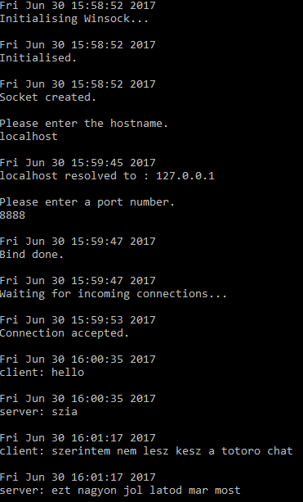
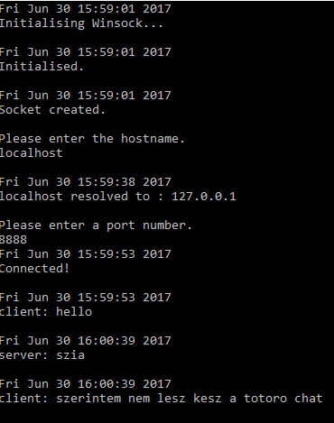
CLIENT-SERVER COMMUNICATION

Slide 5
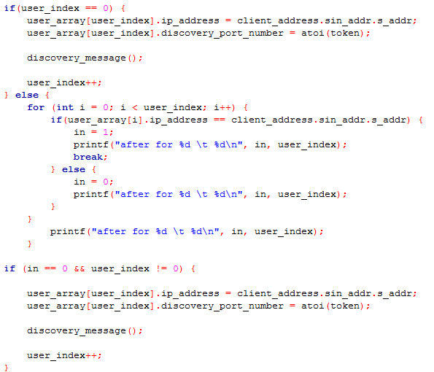
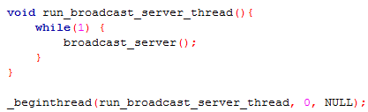
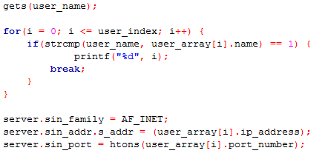
TOTORO Chat
Difficulties

Slide 6
AND SO ON…. THROW YOUR CODE AWAY

Slide 7
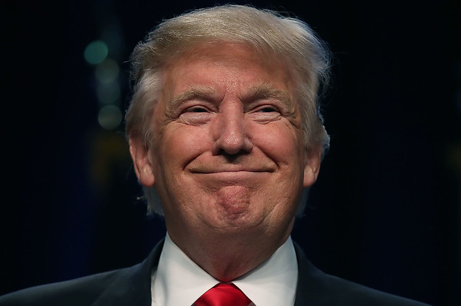
AND I DID IT

Slide 8
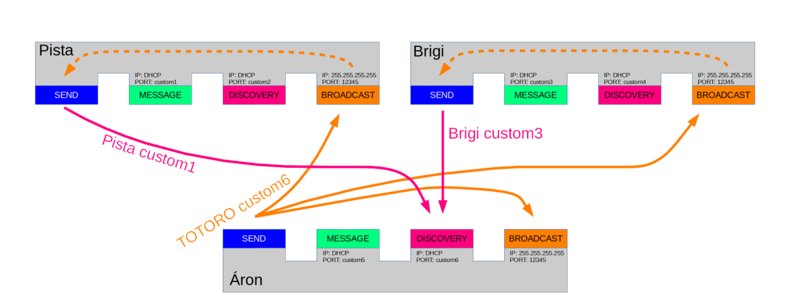

Slide 9
DON’T BE AFRAID TO START YOUR PROJECT AGAIN!

